Slide 1


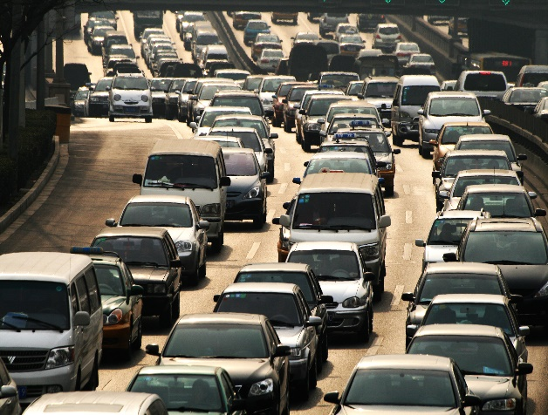


Weekly Report
29/03/2021 to 01/03/2021
By- Shubham Lunker

Slide 2

AGENDA
Tasks
Learnings

Slide 3

TASKS

Slide 4
TASKS
Date and Day | Tasks Performed
Monday - 29/03/2021 | Holiday - Dhuleti Festival
Tuesday - 30/03/2021 | Watched videos on super-service triage – an electronic vehicle health check-up service to understand it’s functionalities. Also, got a brief idea about eVHC is performed step-by-step. Read an article by McKinsey on changing trends in automotive industry which was published in year 2019.

Slide 5
TASKS
Date and Day | Tasks Performed
Wednesday - 31/03/2021 | Presented my understanding on trends in automotive industry by speaking in front of all my team-mates. Prepared and appeared for Web-API viva.
Thursday - 01/03/2021 | Went through the website of autoflex.nl and developed a basic level of understanding on it. Prepared a weekly report for 29/03/2021 to 01/03/2021 which includes the tasks performed, learnings, challenges faced and the documentation skills that I developed along.

Slide 6
LEARNINGS

Slide 7
LEARNINGS
Date and Day | Learnings
Monday - 29/03/2021 | Holiday - Dhuleti Festival
Tuesday - 30/03/2021 | Learnt about how an actual eVHC is performed by seeing the demonstration of SuperService Triage. Also, understood the various processes and stages involved for the same. Understood the importance of “eascy” -> e- electrify , a - autonomous, s - shared, c - connected, y - yearly updated for vehicles in automotive industry.

Slide 8
LEARNINGS
Date and Day | Learnings
Wednesday - 31/03/2021 | When I was sharing my knowledge on trends in automotive industry, it helped me improve upon my communication and presentation skills, as it was reviewed. I had to prepare for Web-API viva in a short interval of time. So, I learnt how can we prepare for something under strict deadlines.
Thursday - 01/03/2021 | I prepared a weekly report in form of a presentation. As a result, it added value to my presentation skills: how to use a template, to create a table in PPT and bullets in it, etc .Learnt basic concepts regarding Garage Management System by examining the website of autoflex.nl.

Slide 9


THANK YOU
Contact us
Head office
NINtec B.V. | Gateway Group
Maria Montessorilaan 5, 2719 DB
Zoetermeer, The Netherlands
Phone
+31 79 320 0980
E-mail
info@autofacets.com

